Slide 1



Slide 2
About me
NAME: RACHAKONDA ABHINAY
DEGREE : BACHELOR IN COMMERCE (computer Applications)
After my Graduation I found interest on IT domine . I start knowing about current treades and industries happenings ,so finally I applied for Data science course in Innomatics research labs.
I have hands-on experience in Data analysis, Power BI, and SQL to contribute to organizational success through proficient data cleaning, statistical analysis, and data visualization. I aim to provide actionable insights and recommendations that empower stakeholders to make informed, data-driven decisions, ultimately driving business growth and efficiency.
Gihub link : https://github.com/abhinay9505/Innomatics_Internship_projects
Linkedin link : https://www.linkedin.com/posts/abhinay-rachakonda-068b58235_github-abhinay9505innomaticsinternshipprojects-activity-7166702505593098240-p5I6?utm_source=share&utm_medium=member_desktop
Busness Problem and Use case domain understanding:
Times of India article dated Jan 18, 2019 states that “After doing your Computer Science Engineering if you take up jobs as a Programming Analyst, Software Engineer, Hardware Engineer and Associate Engineer you can earn up to 2.5-3 lakhs as a fresh graduate.” Test this claim with the data given to you.
Is there a relationship between gender and specialization? (i.e. Does the preference of Specialisation depend on the Gender?)

Slide 3
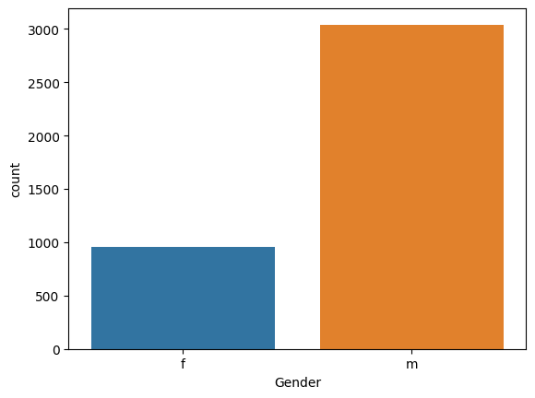
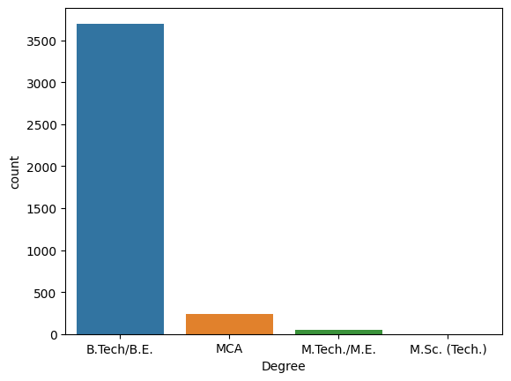
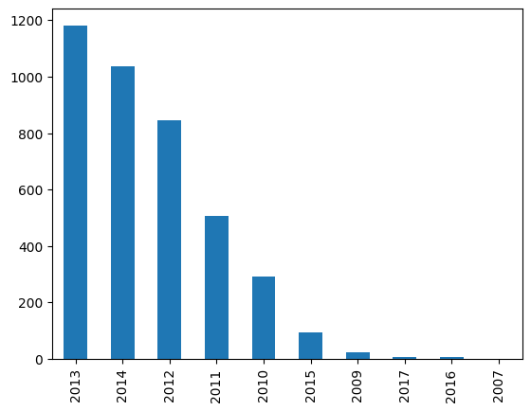
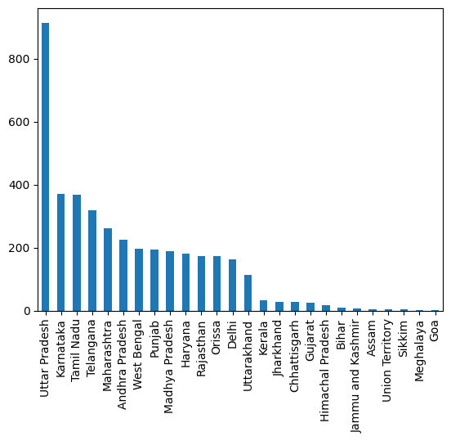
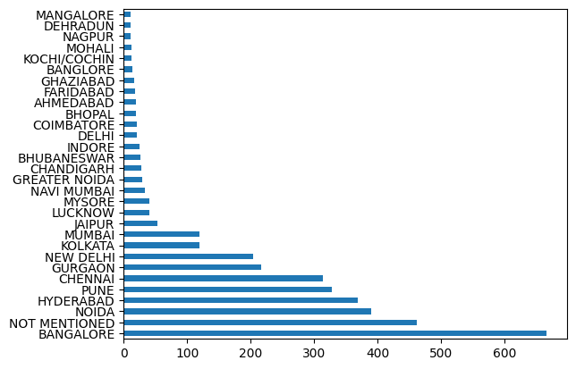
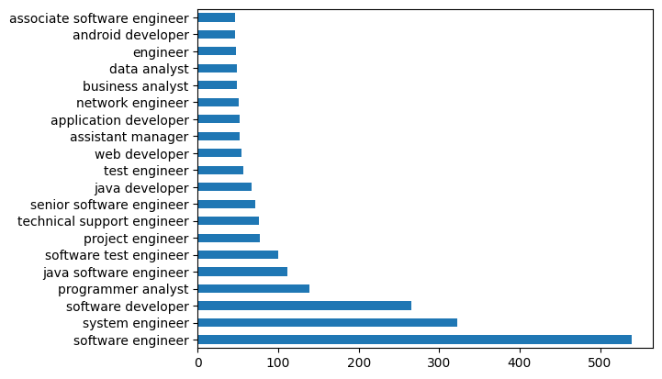
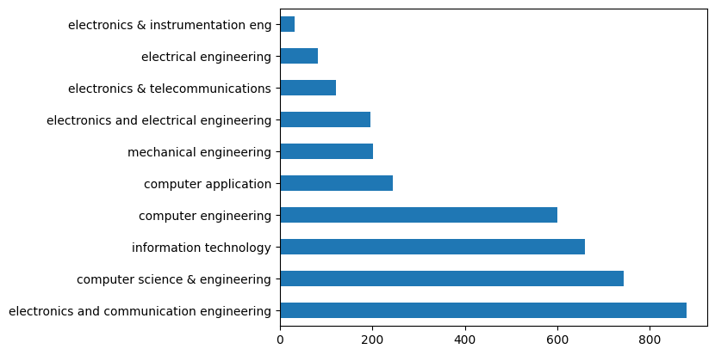
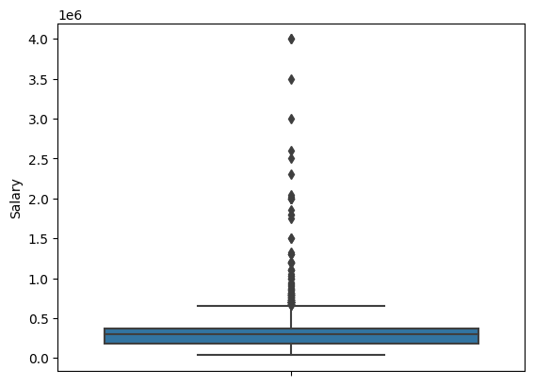
UNIVARITE ANALYSIS

Slide 4
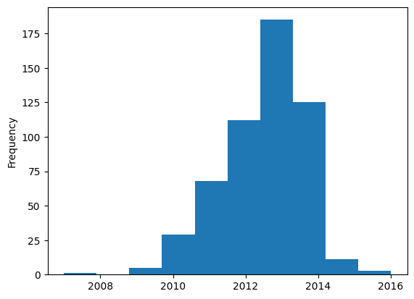
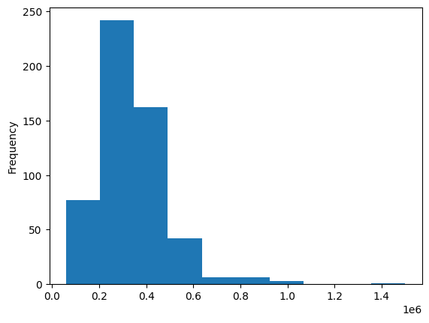
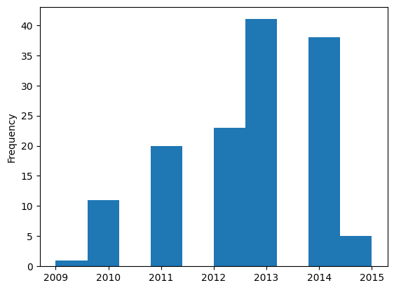
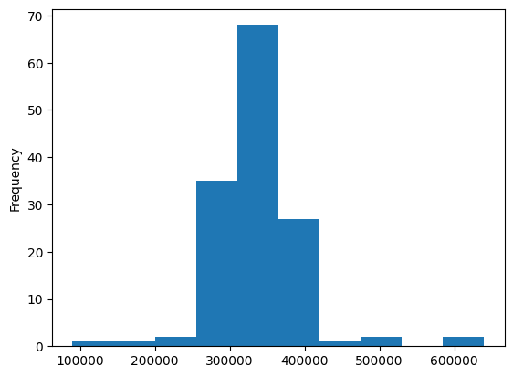
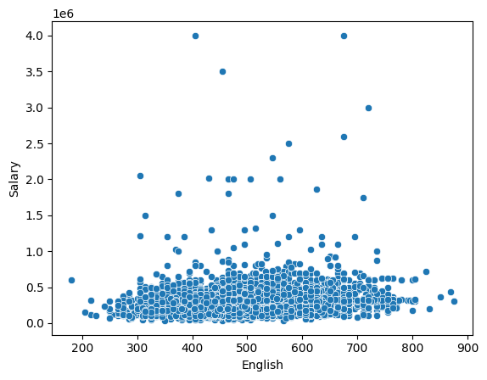
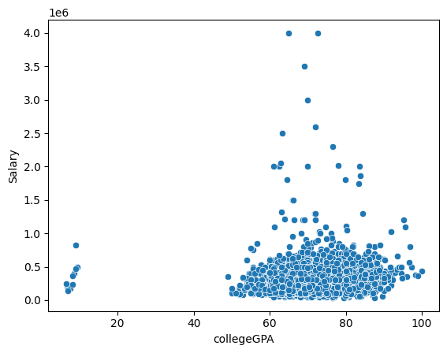
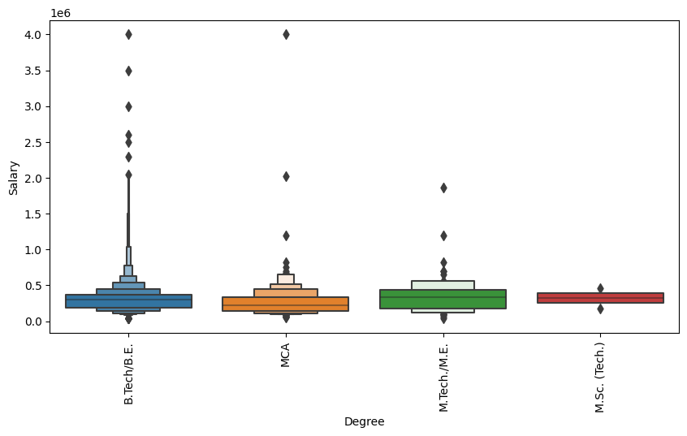
BIVARITE ANALYSIS
Software Engineers Graduation_year Salary Frequency
Programmer analysis Graduation_year Salary Frequency

Slide 5
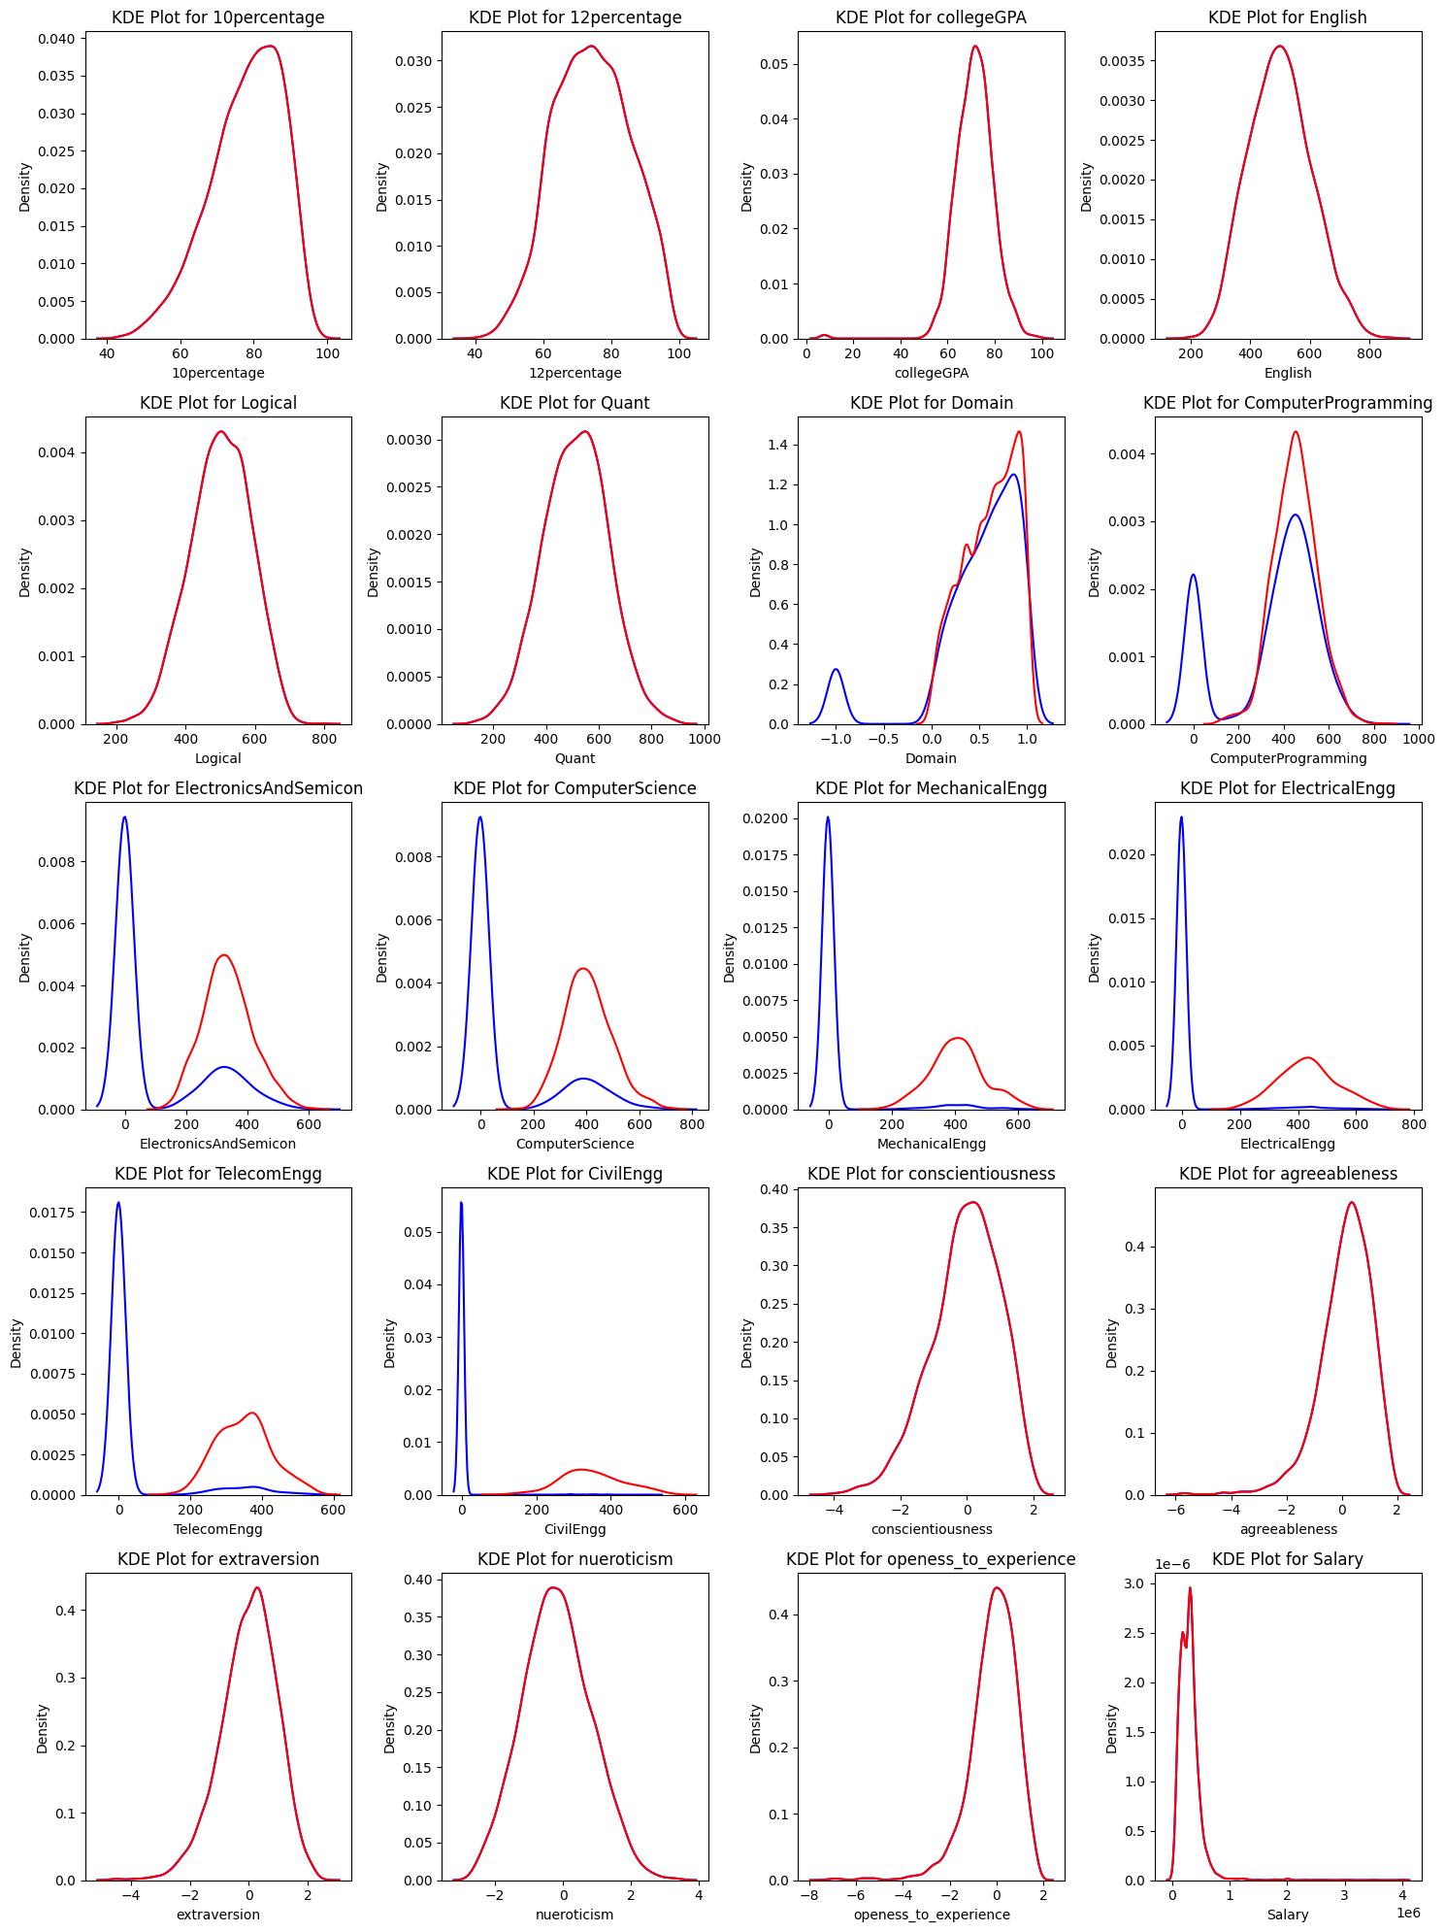
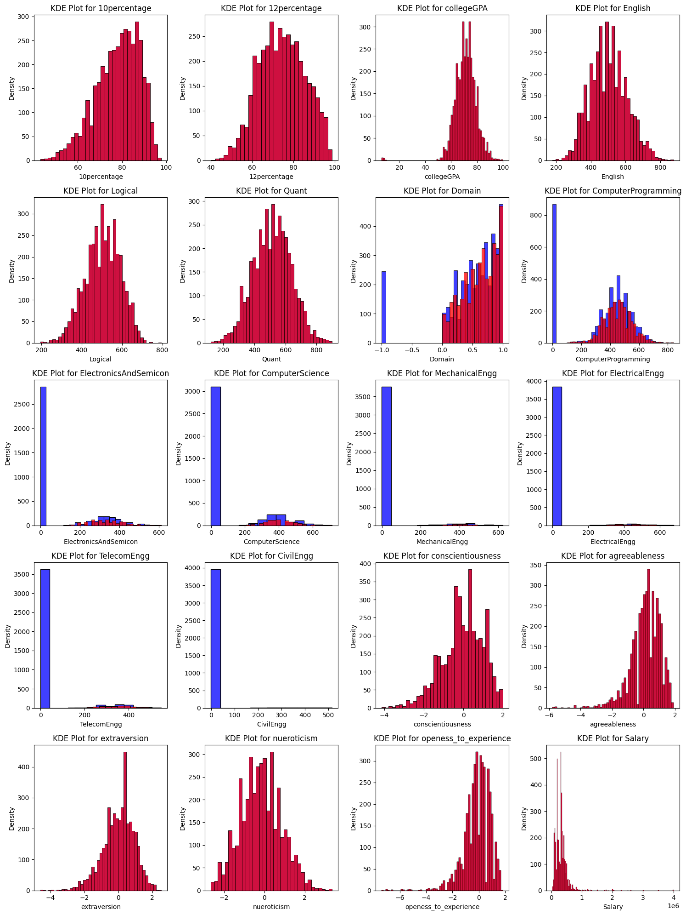

Slide 6
Conclusion:
Aspiring Minds from the Aspiring Mind Employment Outcome 2015 (AMEO).
1.AMCAT mostly B.tech/B.E Graduation more and getting high Salary and secoundly MCA and M.tech Graduation getting Average Salary among B.tech/B.E Graduation.
2.Software Engineers,system Engineers,software delevepors and programming analysis mostly probability in jobs.
3.Accroding to collegeGPA and Graduation salary was high to fresher in jobs.
4.English talking skills salary was determined and mostly city’s Bengalore,Hydrabad,NOIDA,PUNE,CHENNAI most company’s and jobs located .
5.ECE,CSE,IT students are mostly for fresher jobs from B.tech Graduations and passed out students in year 2013,2014 finding more jobs.
6.students attented test for there b.tech streams tests other steams students other demain test.

Slide 7

THANK YOU

